Slide 1
Transition from Traditional Waterfall to Agile Software Development
The Shift from prescriptive software development to the Agile software Development
The Essence of Agile philosophy
A brief overview of popular agile methods namely, Scrum, Extreme Programming and Feature Driven Development (FDD) followed by a comparative analysis

Slide 2
Shift From Prescriptive Software Development To The Agile Software Development

Slide 3
Shortcomings of Waterfall Model
Deceptively simply “requirements box” of the waterfall model
An ineffective treatment of requirements led to “challenged” Projects
Lack of User input: 13% of all Projects
Requirements and specifications: 12% of all projects
Changing Requirements and Specifications 12% of all projects
Source: Leffingwell, “Agile Software Requirements, Lean Requirements Practices for Teams, Programs and he Enterprises”

Slide 4
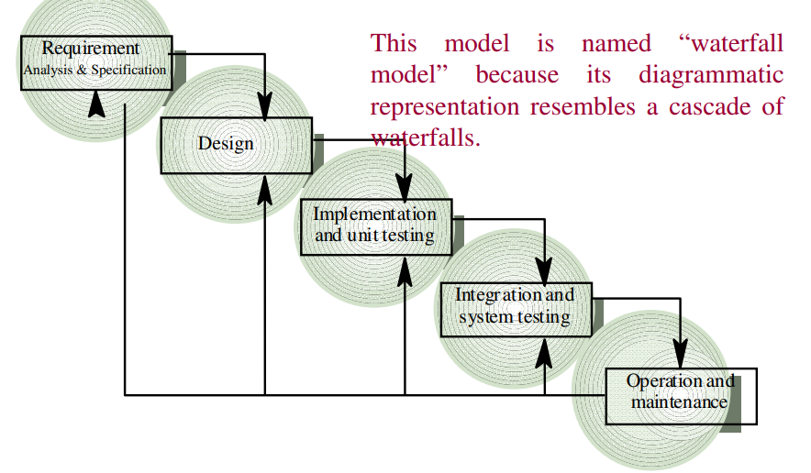
Waterfall model

Slide 5
Giant step forward for the industry
Emergence of Iterative and Incremental Approach in 1980s and 1990s
Rapid Development of understanding via experimental discovery (Spiral)
Rapid build of models, prototypes and initial systems using more advanced tools (RAD)
Iterative and incremental development of ever larger and more complex systems (RUP)

Slide 6
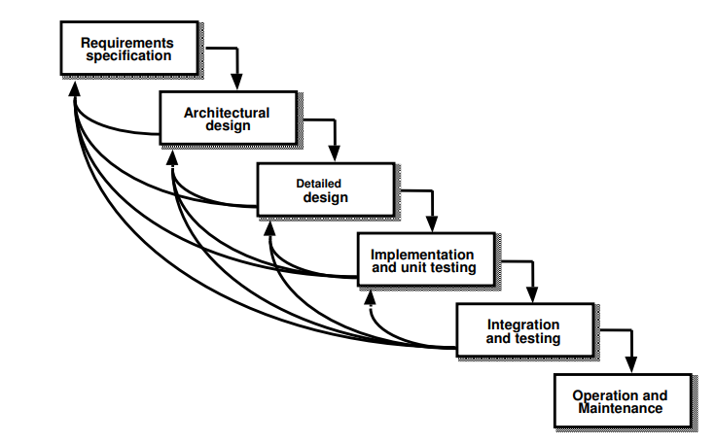
Iterative and Enhancement Model

Slide 7
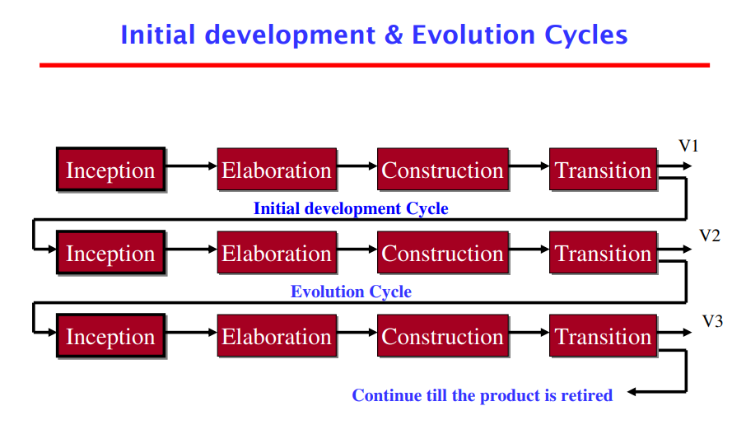
Rational unified process (RUP)

Slide 8
Adaptive (Agile) Processes
Starting in the late 1990s and through the current decade,
An explosion of lighter-weight and ever-more-adaptive models
Based on a different economic foundation
more cost effective to write the code quickly, have it evaluated by customers in actual use, be “wrong” (if necessary), and quickly refactor it

Slide 9
Agile Manifesto
Individual and interactions over processes and tools.
Working software over comprehensive documentation.
Customer collaboration over contract negotiation.
Responding to change over following a plan

Slide 10
Agile Principles
Customer satisfaction by early and continuous delivery of valuable software.
Welcome changing requirements, even in late development.
Working software is delivered frequently (weeks rather than months).
Close daily cooperation between business people and developers.
Projects are built around motivated individuals, who should be trusted.

Slide 11
Some Popular Agile Methodologies
Scrum
Extreme Programming (XP)
Feature Driven Development(FDD)
Lean/ Kanban
The most widely adopted agile methods are Scrum and XP.

Slide 12
Agile Methods
SCRUM
Extreme Programming XP
Feature Driven Development FDD

Slide 13
Framework
Roles
Product owner
Scrum master
Team
Events
Sprint planning
Sprint review
Sprint retrospective
Daily scrum meeting
Artifacts
Product backlog
Sprint backlog
Burndown charts

Slide 14


Key Practices
Work is done in “sprints” which are time boxed durations of a fixed 30 days or fewer duration
Work within a sprint is fixed
All work to be done is characterized by a product backlog, which includes new requirements to be delivered, the defect workload and the infrastructure and design activities.

Slide 15
Key Practices
A scrum master mentors the empowered self organizing and self accountable teams that are responsible for delivery of successful outcomes at each sprint.
Product Owner plays the role of customer proxy
A daily Stand-up meeting is a primary communication method

Slide 16
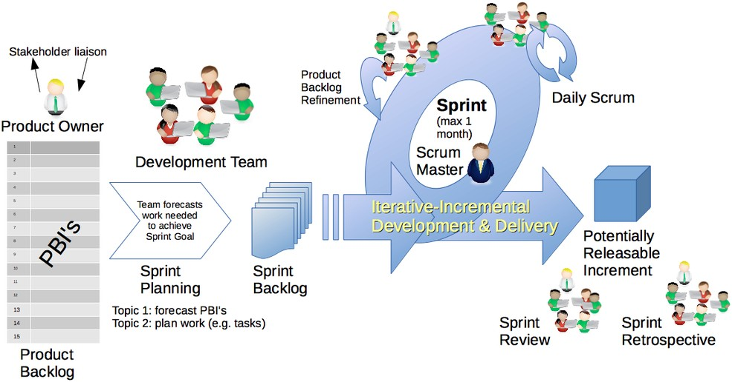
Workflow

Slide 17
Agile Methods
SCRUM
Extreme Programming XP
Feature Driven Development FDD

Slide 18
Extreme Programming (XP)
A team of eight to ten members work at one location with customer representative on-site
Development occurs in frequent builds or iterations , which may or may not be releasable
Requirements are specified as user stories, each a chunk of new functionality the user requires
Programmers work in pairs, follow strict coding standards and do their own unit testing, customers participate in acceptance testing.
XP, originally described by Kent Beck.

Slide 19
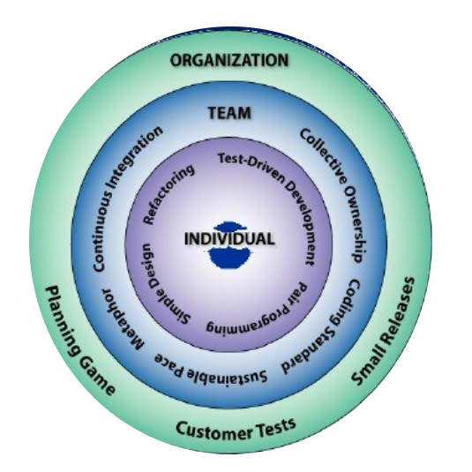
The 12 key Practices

Slide 20
Agile Methods
SCRUM
Extreme Programming XP
Feature Driven Development FDD

Slide 21
Feature Driven Development Process
🠶 Process #1: Develop an Overall Model
🠶 Process #2: Build a Features List
🠶 Process #3: Plan By Feature
🠶 Process #4: Design By Feature
🠶 Process #5: Build By Feature

Slide 22
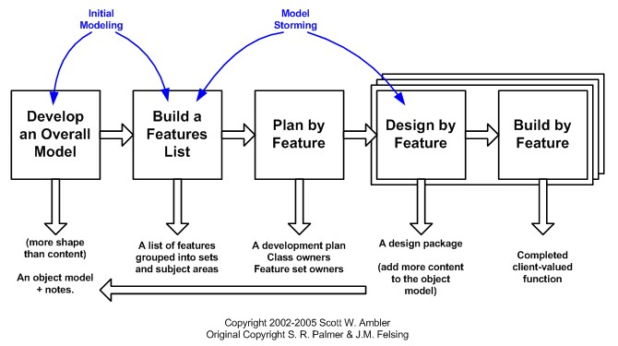
Feature Driven Development Process

Slide 23
Process #1: Develop an Overall Model
Develop an overall model
Build a features list
Design by feature
Build by feature
Plan by feature
Who? Domain experts, chief architect, chief programmers.
Establishes the shape of the system
Defines classes, how classes related to each other
Creates the base object model
Includes internal and external reviews, model notes
Goal - for team members to gain a good, shared understanding of the problem domain and build a foundation

Slide 24
Process #2: Build a Features List
Develop an overall model
Design by feature
Build by feature
Build a features list
Plan by feature
Who? Feature List Team: domain experts, chief programmers, chief architect
Functional decomposition of model developed in step 1
Subject area to business activity to business activity step
Feature is a business activity step, customer centric not technology centric
Nomenclature: <action> <result> <object>
“Generate an account number for the new customer

Slide 25
Process #3: Plan By Feature
Develop an overall model
Build a features list
Design by feature
Build by feature
Plan by feature
Who? The Planning Team: the project manager, the development manager, and chief programmers.
Group features into feature sets (one or more business activities)
Prioritize based on customer need
Establish completion dates (MM/YYYY)
Assign responsibilities to team members
Determine Class Owners
Assign feature sets to chief programmers

Slide 26
Process #4: Design By Feature
Develop an overall model
Build a features list
Plan by feature
Design by feature
Build by feature
Who? The Feature Team: chief programmer, class owners
Form Feature Teams
Team members collaborate on the full low level analysis and design
Certain features may require teams to bring in domain experts
Teams need to update the model artifact to support their changes
Fleshes out class and object design, create sequence diagrams as necessary

Slide 27
Process #5: Build By Feature
Develop an overall model
Build a features list
Plan by feature
Design by feature Build by feature
Who? Class owners, chief programmers
Implement
Code inspection
Unit test
Promote to build

Slide 28
Comparison Between Different Agile Methods
Characteristics | XP | Scrum | FDD
Approach | Iterative increments | Iterative increments | Iterative
Time Period for Iteration | 1 to 6 weeks | 2 to 4 week s | 2 days to 2 weeks
Team Size | small teams (<10 members) | All Sizes | Many members and more than one team
Suitable Project Size | For smaller Project | all types o f projects | m ore complex projects
User involvement | user highly involved | Involvement through the product owner | Involvement through rep ort s
Documentation | only basic documentation | only basic documentation | Documentation is importan t
Major Practices | User Stories, Test driven development, Refactoring, Pair Programming, strict practices for coding | Sprint, Product and sprint Backlog, Scrum meetings | UML Diagrams

Slide 29
Thanks

Slide 30
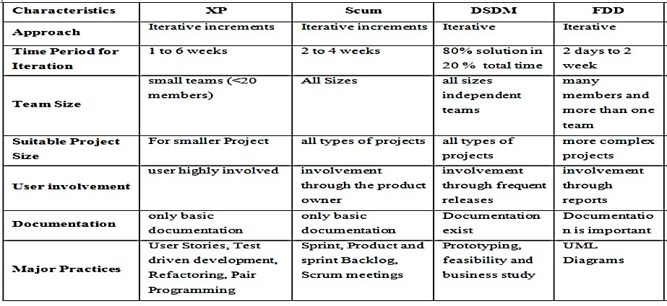
COMPARATIVE STUDY

Slide 31


CASE STUDY
🠶 The case study was performed in controlled environment – in a course called Application Development—a four credit hours course at UTM.
🠶 The course began by splitting up the class to seven software development groups
and two groups were chosen to implement the existing process of FDD.
Two basic goals of this experiment of case student were
1 To introduce students to a variety of software processes in Agile. 2 To get students to adapt security in their system in FDD manners.
🠶 We wanted to investigate that by adding security elements in the system while applying
FDD processes, whether it was possible to handle changes

Slide 32
Introduction
🠶 In the case study, the students who did not have any experience or skills in implementing security element in the system, managed to learn new skill in a semester.
🠶 Later we shall see, how the student were assigned tasks on managing the system development process in addition security elements that have been added as late requirements.
🠶 The main focus shall be on how the course gets students to think
about how they
manage when new security requirement when they are in FDD process in developing their system.

Slide 33
Overview
🠶 The course began by introducing a variety of software processes in Agile to students. Then we chose two groups to apply FDD while other 5 groups applied other Agile
software process such as Scrum and XP.
🠶 After that, a two week introduction to FDD was conducted. Then, the students started the documentation as advised. After that the course continued with implementing the design.
🠶 While the students were busy doing the project, the lecturer suddenly changed the requirements during second month.
🠶 The tasks list was to implement security element like SQL injection, encryption, session management and others that relate towards their system.
🠶 At the end the students compared the estimated date of completion of the system with the previous date of completion set during the first week of course. They had to check whether they overrun the dateline or not and if they overrun the dateline, what were the reasons that they overboard the dateline

Slide 34
IMPLEMENTING FDD
🠶 As the class project started, the students were divided to seven groups. Two groups were given the task of completing their system project using FDD model and there were guided with all the phases of FDD
(A) Develop an Overall Model Phase
In this phase the students were familiarized with this agile model. They needed to perform their requirement and made it into a overall model for the whole system where they did using Enterprise Architecture (EA) tool. EA tool helped them create a
whole model to depict the whole modules of the system. Both team managed to come out
with 5 modules.

Slide 35
IMPLEMENTING FDD
(B) Build a Feature List
🠶 This is the next phase after finishing the overall model for the system. They need to
identify the features that listed under the module.
🠶 For instance, the system has a module of Quota Package. Therefore the features are Apply Quota, View List, Approve Quota, Reject Quota, Reject Quota and Update Quota List.
The task is that one group must have at least 20 features in their project.
🠶 This phase also have been done using EA tool where each features are noted in use case diagram.

Slide 36
IMPLEMENTING FDD
(C) Plan by Feature
🠶 This third phase is the most crucial phase where all the planning of the project started here. The student must really need to prepare the planning documentation for each module that they have created. Each module must has estimation time to be completed.
🠶 As far as concern, feature sets with completion dates, Chief Programmers assigned to feature sets, a list of classes and the developers that own them must be listed in their planning documentations. However each team has different kind of planning documentation. One of the group must do the planning using gantt chart where else the other group used mind maps.
🠶 The main reason why this method was used to determine whether by using gantt chart or by using mind map could help to see the overall progress of the development better.

Slide 37
IMPLEMENTING FDD
Design by Feature
🠶 This phase required the students to be more precise on how they going to design their system by feature. Each feature must have a sequence diagram and class diagram to picture their system looks like.
🠶 This phase is also important to show to their customer how the system operates so that any confusion or disagreement could be settled before the developers starting developing the system.
Build by Feature
🠶 This phase is the last phase where the technical part comes in action. After a thorough check on the design, they started developing the system by module one after another.
🠶 The lecturer has appointed one to two weeks to complete one module. Even though both teams were using FDD, but they were using different programming language and tools to complete their system.
🠶 While completing the system they will also update their gantt chart or their mind maps.

Slide 38
IMPLEMENTING FDD
RECOMMENDATIONS
🠶 This is the part where the students that have complete their phases in the FDD to voice out their opinion about the weaknesses that they find in the existing FDD model to adapt with security feature.
🠶 A set of questionnaire have been distributed to the FDD members to ask them about their opinion throughout the implementation of system. The questions that been asked are as follows:
Through your experience in FDD process development, explain briefly weaknesses in FDD modelling.
When the lecturer asked you to add security features/elements inside your system, do you
think that it slowed down your system development progress? Give reason.
Based on your experience throughout the course, suggest ways to improve the whole FDD development process if security features need to be added inside the system.
Between gantt chart and mind map, which do you find better in planning and tracking the
progress of the project.

Slide 39
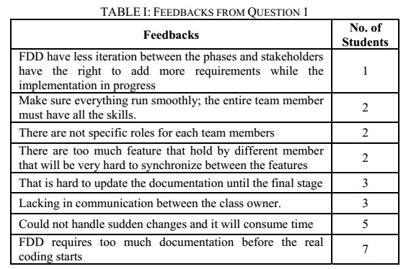
IMPLEMENTING FDD

Slide 40
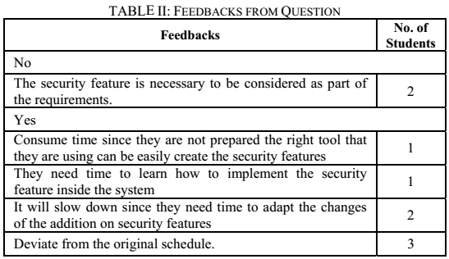
IMPLEMENTING FDD

Slide 41
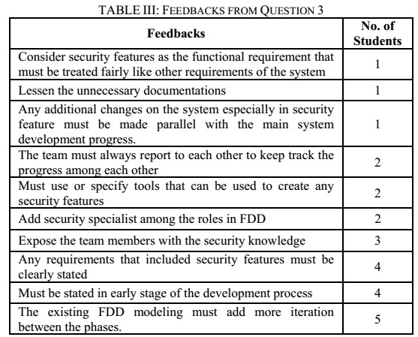
IMPLEMENTING FDD

Slide 42
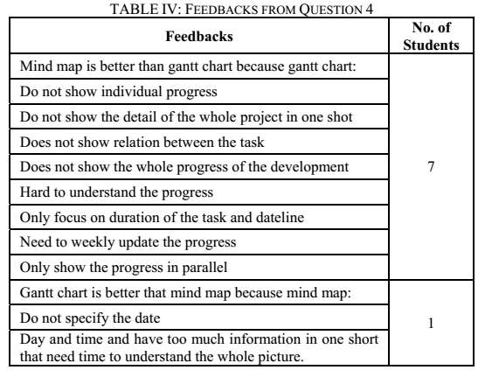
IMPLEMENTING FDD

Slide 43
CONCLUSION AND FUTURE WORKS
🠶 Based on our observations, we can say that it is possible that FDD could manage well with security of security of software if this model is carefully analyzed and implemented with some of the security practices, plan the right tool, add more iterations between the phases of FDD and use mind map tool, to get a clearer view of the whole progress in the planning phase.
🠶 We noticed that, even if the students that were still new in developing a secure system and never heard off or familiarized with the secure software development could pull off with little difficulty. However, we noticed that FDD needs to be remodeled to clearly define the process towards secure software development.
🠶 Sometimes, the current defined roles in FDD are not sufficient. After these improvements, we think that the large scale secure systems (including in the industry sector) would have no problem in developing secured software.
🠶 Thus, in our future we intend to propose security phase and security master role for FDD.

Slide 44
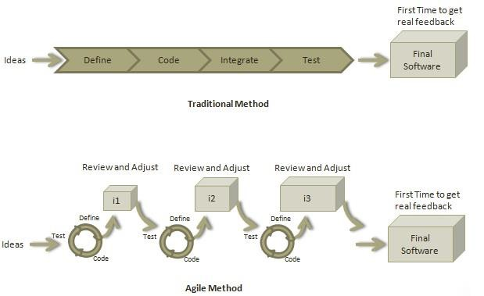
TRADITIONAL VS AGILE APPROACH

Slide 45
TRADITIONAL VS AGILE APPROACH
Traditional Method | Agile Method
Sequentially from start point to end point | Incremental and iterative approach
Design process is not broken into an individual models | Broken into individual models that designers work on
Customer can only see the product at the end of the project | Make early decision and changes to the project
Only at the end, the whole product is tested. Start again if error found in middle | Error can be fixed in the middle of the project.
Development process is phased. | Project is executed in short (2-4) weeks iterations.
Testers work separately from developers | Testers and developers work together
Documentation is a top priority | Documentation attends less priority than software development

Slide 46
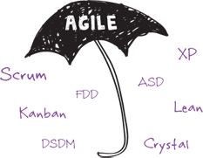
WHAT IS AGILE SOFTWARE DEVELOPMENT METHODOLOGY?
🞂 An incremental, iterative approach to software development
🞂 These methods are open to changes in requirements over time and encourage constant feedback from customers.

Slide 47
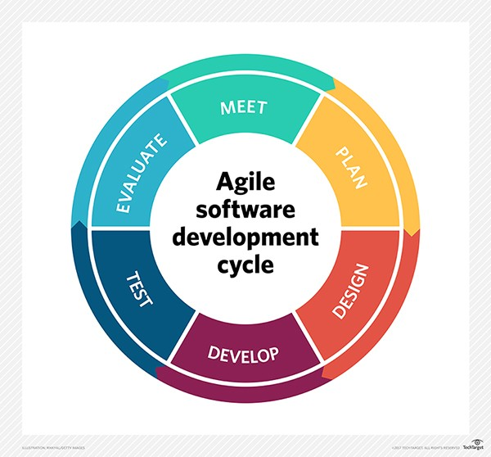

Slide 48
12 PRINCIPLES
🠶 Customer satisfaction
🠶 Welcome Change
🠶 Deliver a Working Software
🠶 Collaboration
🠶 Motivation
🠶 Face-to-face Conversation
🠶 Measure the Progress as per the Working Software
🠶 Maintain Constant Pace
🠶 Monitoring
🠶 Simplicity
🠶 Self-organized Teams
🠶 Review the Work Regularly

Slide 49
4 VALUES
🠶 Individuals and Interactions more than processes and tools
the team is more important than the tools
🠶 Working Software more than comprehensive documentation
It is vital that the application works
🠶 Customer Collaboration more than contract negotiation The client should be involved in development
🠶 Responding to Change more than following a plan
Initial planning and structure of the software must be flexible to allow changes

Slide 50
Why scrum?
Welcome changing requirements, even late in development
Deliver potential working software early
Early visibility of business
Easy to keep track of project progress
Self organizing teams

Slide 51


PRODUCT BACKLOG
-
-
-
-
1
-
-
-
-
I
I
-
I
I
-
-
-
-
-
-
-

Slide 52






PRODUCT BACKLOG
1 -- 1 1
IO
'""""-i=i'.=--'
1,,;_..=_,J l.;;;;; E.--
a ---- . =-
-----'--=
--
. --
--
.
'
. " ' - ,.....,.....,.,,,,._,, ._ , _.,,,,,,.....
- -
- -

Slide 53

Sprint Backlog

Slide 54
'
..
.
---
.
"
.
.
Work Remaining
.
---
.,.
,..
r-
. r-
-
-
-
-
J_-
-·
J
25
'
01
05
10
15
,:,...
N20
30
0
(/l
(/)
-0
-,

Slide 55
Twelve Supporting Practices
Planning Game Small Releases
Customer Acceptance Tests Simple Design
Pair Programming
Test-Driven Development Re-factoring
Continuous Integration Collective Code Ownership Coding Standards Metaphor
Sustainable Pace
●
●
●
●
●
●
●
●
●
●
●
●

Slide 56
Analysis & Design
The main goal of the analysis & design discipline is to show how the system will be realized in the implementation phase.
The purpose of analysis and design is as follows:
To translate the requirements into a specification that describes how to implement the system
To establish robust architecture so that you can design a system that is easy to understand, build, and evolve

Slide 57
How Do I Start This XP Thing?
Start out collecting user stories and conducting spike solutions for things that seem risky. Spend only a few weeks doing this.
Then schedule a release planning meeting. Invite customers, developers, and managers to create a schedule that everyone agrees on.
Begin your iterative development with an iteration planning meeting.
Now you're started.

Slide 58
Usual Type Of Projects XP Receive
Usually projects come looking for a new methodology like XP only after the project is in trouble.
In this case the best way to start XP is to take a good long look at your current software methodology and figure out what is slowing you down. Add XP to this problem first.

Slide 59
When should Extreme Programming be Used?
Can be used in the problems domains where requirements change.
XP was also set up to address the problems of project risk.
The XP practices are set up to mitigate the risk and increase the likelihood of success.
XP projects unanimously report greater programmer productivity when compared to other projects within the same corporate environment. But this was never a goal of the XP methodology. The real goal has always been to deliver the software that is needed when it is needed. If this is what is important to your project it may be time to try XP.

Slide 60
EXTREME PROGRAMMING (XP)

Slide 61
What is scrum?
Agile way of Project Management
A team based collaborative approach
Iterative & incremental development
Always focus to deliver business value

Slide 62
Meetings
The sprint review
Team presents what it accomplished during the sprint
Typically takes the form of a demo of new features or underlying architecture
Whole team participates
Sprint retrospective
Periodically take a look at what is and is not working
Typically around 30 minutes
Done after every sprint
Whole team participates including Scrum Master, Product Owner, Team and possibly customers

Slide 63
Extreme Programming
It is based on four simple values
Simplicity,
Communication,
Feedback
Twelve supporting practices.

Slide 64
Criticisms Faced By The Methodology
A methodology is only as effective as the people involved, XP can’t solve it.
Lack of structure and necessary documentation.
Requires too much cultural change to adopt.
Can be very inefficient; if the requirements for one area of code change through various iterations, the same programming may need to be done several times over.

Slide 65
FDD HISTORY
FDD was first introduced to the world in 1999 via the book Java Modeling In Color with UML, a combination of the software process followed by Jeff DeLuca's company and Peter Coad's concept of features
FDD was first applied on a 15 month, 50-person project for a large Singapore bank in 1997

Slide 66
SCRUM V/S FEATURE DRIVEN DEVELOPMENT
Scrum does not specify any particular engineering practice but feature driven development specify specific engineering practices i.e design/code inspection, tests.
Scrum has shorter feedback loops, but feature driven development has longer feedback loop.
Scrum has self-organizing teams but feature driven development team have recognized roles i.e project manager, chief architect, development manager, chief programmer, class owner and domain expert.

Slide 67
PROJECT SCOPE AND PLAN
The project scope and plan is simply and quickly created by manipulating the cards by hand.
There are three levels of plans. One which looks a few months into the future and groups stories into larger deployments. Another plan for stories in the next iteration. And finally a break down of stories into tasks with developer sign up for the current iteration.
Plans are considered temporary artifacts in XP.
You will be expected to re-create your plans before they expire. Every time the customer gains insight you will make a new plan. Every time you slip or get ahead of your schedule you will make a new plan.

Slide 68
User Participation
In XP, the “Customer” works very closely with the development team to define and prioritize granular units of functionality referred to as “User Stories”.

Slide 69
Roles
Product Owner
Define the features of the product
Makes scope vs. schedule decisions
Responsible for achieving financial goals of the project
Prioritize the product backlog
Adjust features and priority every sprint, as needed
Accept or reject work results
Scrum Master
Coaches the team to their best possible performance
Helps improve team productivity in any way possible
Enable close cooperation across all roles and functions
Shield the team from external interference

Slide 70
The Team
Typically 5-9 people
Cross-functional
Programmer, tester, designers, etc.
Members should be full-time
Teams are self-organizing
Membership should change only between sprints

Slide 71
Product Backlog
It is the list of all the features(user stories) that we wish to include in our product. It consists of
Features
Bug fix
Non functional requirements and many more
It is the role of product owner to prioritize product backlog

Slide 72
Sprint Planning
At the beginning of a sprint, the scrum team holds a sprint planning event to:
Communicate the scope of work that is intended to be done during that sprint
Select product backlog items that can be completed in one sprint
Prepare a sprint backlog that includes the work needed to complete the selected product backlog items

Slide 73
Burndown Charts
The sprint burn-down chart is a public displayed chart showing remaining work in the sprint backlog.
Updated every day, it gives a simple view of the sprint progress. It also provides quick visualizations for reference.
The horizontal axis of the sprint burn-down chart shows the days in a sprint, while the vertical axis shows the amount of work remaining each day.
During sprint planning the ideal burndown chart is plotted. Then, during the sprint, each member picks up tasks from the sprint backlog and works on them.
At the end of the day, they update the remaining hours for tasks to be completed. In such a way, the actual burndown chart is updated day by day.

Slide 74
Sprint Backlog
The sprint backlog is the list of work the development team must address during the next sprint.
The list is derived by the scrum team progressively selecting product backlog items in priority order from the top of the product backlog until they feel they have enough work to fill the sprint.
The sprint backlog is the property of the development team, and all included estimates are provided by the development team.

Slide 75

Meetings
The Daily Scrum
It is a stand up meeting that happens daily for 15 minutes
All members are invited
Only team members, Scrum Master, product owner, can talk
Helps avoid other unnecessary meetings
These 3 main questions are answered
What did you do yesterday?
What will you do today?
Is anything in your way?

Slide 76
FEATURE-DRIVEN DEVELOPMENT
FDD is a client-centric, architecture-centric, and pragmatic software process.
Model-driven, short-iteration process.
Lightweight Agile method for developing software.
Practices are all driven from a client-valued functionality (feature) perspective
This method is focused around "designing & building" features
Main purpose is to deliver tangible, working software repeatedly in a timely manner

Slide 77
WHAT IS FEATURE ?
As the name implies, Features are an important aspect of FDD.
A feature is a small, client-valued function
Features are to be “small” in the sense they will take no more than two weeks to complete
Features that appear to take longer are to be broken up into a set of smaller
features
Feature naming template:
<action> the <result> <by|for|of|to> a(n) <object> Examples: Calculate the total of a sale
Validate the password of a user

Slide 78
FEATURE DRIVEN DEVELOPMENT
It begins with establishing an overall model shape.
Then it continues with a series of two-week “design by feature, build by feature” iterations.
The features are small, “useful in the eyes of the client” results.
The advantage of using FDD is that it is scalable even to large teams due to the concept of ‘just enough design initially’ (JEDI)
It is used in enterprise projects as well as web projects

Slide 79
SIX PRIMARY ROLES
Project Manager- Administrative lead, Operates project system(eg. Togethersoft control center) Shields participants from external distractions
Chief Architect- Responsible for the overall design, Runs design workshops, Steers project through technical obstacles.
Development Manager-Leads day to day development activities, Resolves resource conflicts
Chief Programmers- Experienced developers, Leads smaller teams of individual developers
Class Owners- Individual developers, Design, code, test and document features
Domain Experts- Users, clients, sponsors, etc., Knowledge base for developers

Slide 80
CLASS OWNERSHIP
Class assigned to specific developer.
Class owner responsible for all changes in implementing new features
An individual will take on one or more roles on a project.

Slide 81

Reporting
FDD emphasizes the ability to provide accurate, meaningful, and timely progress information to all stakeholders within and outside the project.
For accurate state reporting and keeping track of the software development project it is however important to mark the progress made on each feature
The first three milestones are completed during the Design By Feature activity, the last three are completed during the Build By Feature activity

Slide 82
BEST PRACTICES IN FDD
Domain object modelling, the creation of a high-level class diagram and supporting artifacts that describes the problem domain.
Developing by feature function that is too complex further decomposed into smaller functions until each sub-problem is small enough to be called a feature
Individual class ownership distinct pieces or grouping of code are assigned to a single owner.
Owner is responsible for the consistency, performance, and conceptual integrity of the class.
Developers work together in feature teams.
A feature team is a small, dynamically formed team that develops a small activity

Slide 83
BEST PRACTICES IN FDD cont..
Inspections are an important aspect of FDD to ensure good quality design and code, primarily by detection of defects.
FDD also insists on regular builds, similar to XP, ensure there is always an up-to-date system that can be demonstrated to the client and helps highlighting integration errors of source code for the features early.
Configuration management.
Configuration management helps with identifying the source code for all features that have been completed to date and to maintain a history of changes to classes as feature teams enhance them.
Reporting/Visibility of results, similar to XP
By frequent, appropriate, and accurate progress reporting at all levels inside and outside the project, based on completed work, managers are helped at steering a project correctly.

Slide 84
COMPARATIVE ANALYSIS OF AGILE SOTWARE METHODS
SCRUM V/S EXTREME XP
Scrum does not recommend any of engineering customs but in XP engineering. Customs like-
test driven development;
refactoring;
pair programming;
automated testing are supported by XP.
In scrum , customer stories are accumulated in (i) product backlog (ii) sprint backlog. But XP stores the stories in “parking lot”.

Slide 85
SCRUM vs FDD
SCRUM | FDD
Does not specify any particular engineering practice | Specific engineering practices i.e. design/code inspections, tests
Focus on producing vertical slices of functionality acceptable to product owner | Domain driven
Shorter feedback loops | Longer feedback loop
Self-organizing teams | Feature team have recognized roles i.e. Project Manager, Chief Architect, Development Manager, Chief Programmer, Class Owner, and Domain Expert
Shared code ownership | Class ownership

